Slide 1
NUMERIC DATATYPE
Operations on

Slide 2
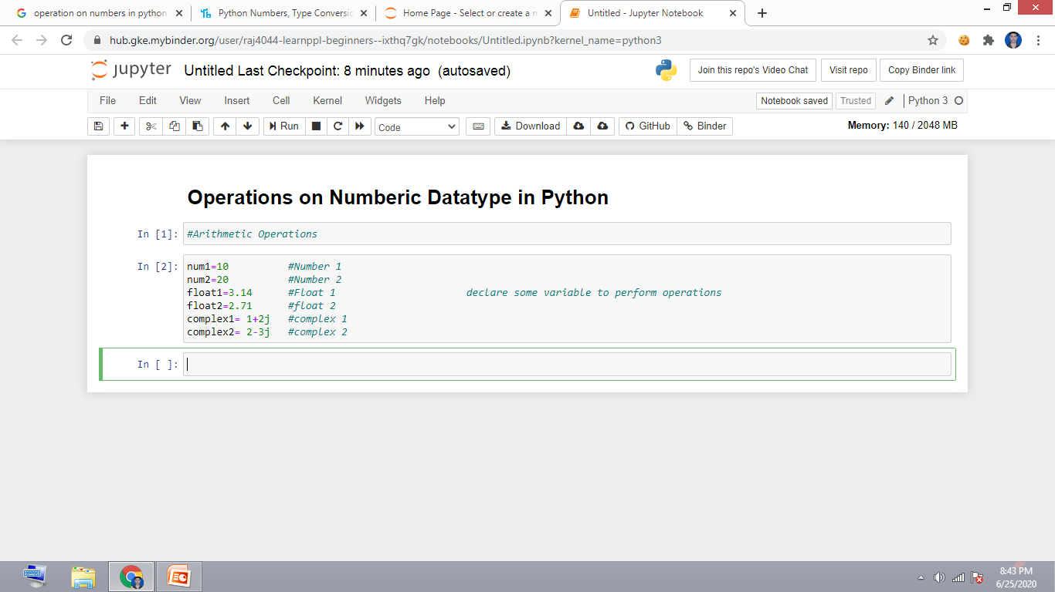
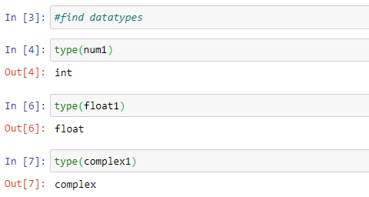
Declare some numbers & check their datatypes

Slide 3
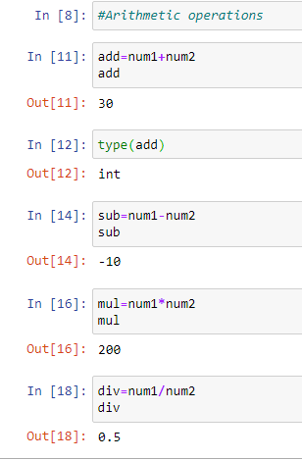
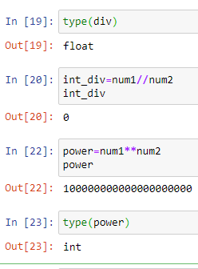
Arithmetic Operations on int

Slide 4
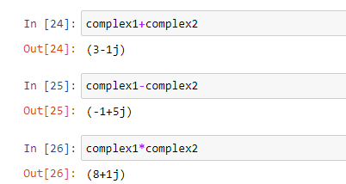
Arithmetic Operations on complex

Slide 5
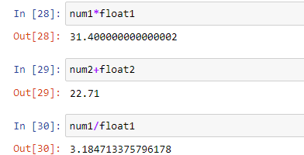
Operate int with float

Slide 6
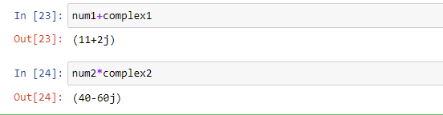
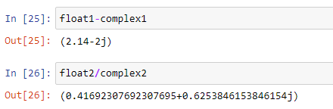
Operate int with complex
Operate float with complex

Slide 7
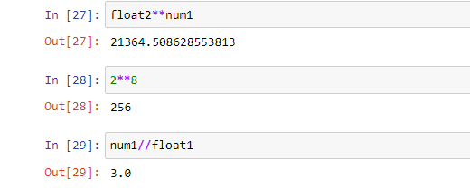
Special Operations

Slide 8
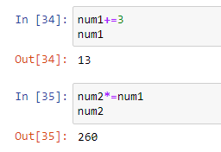
Assignment Operation

Slide 9
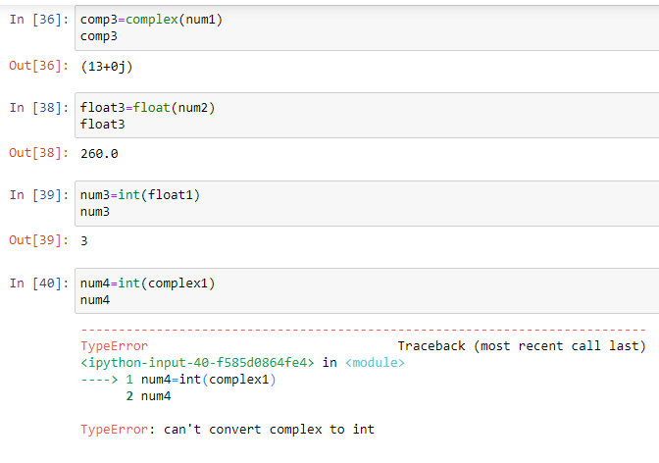
Conversion of types

Slide 10
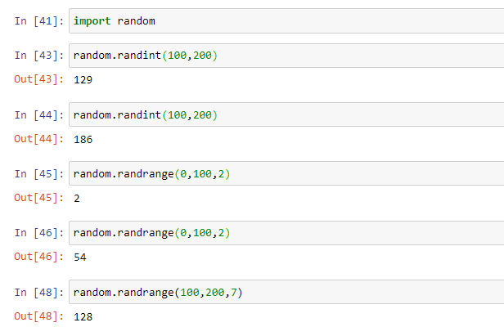
Creating Random number

Slide 11
Tell us
Do you know some Python string operations?
If yes:
Comment below
If no:
Wait for the next lecture
Subscribe

